Slide 1
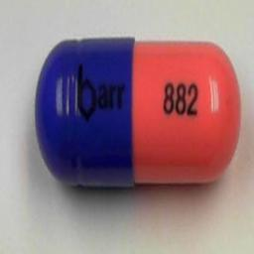
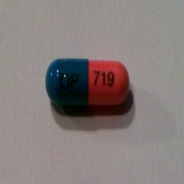
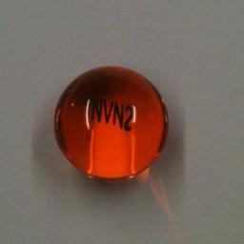
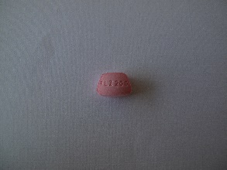
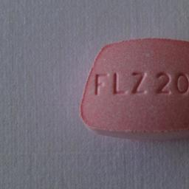
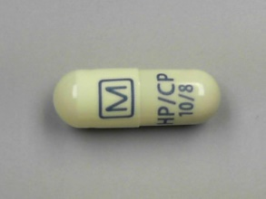
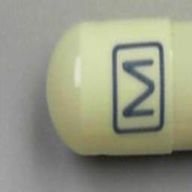
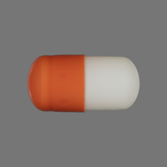
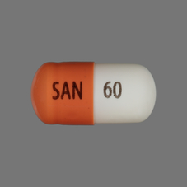
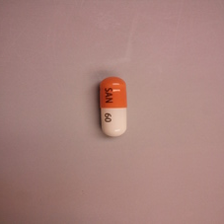
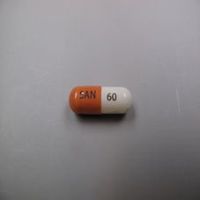
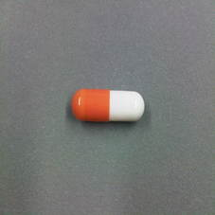
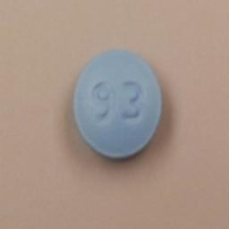
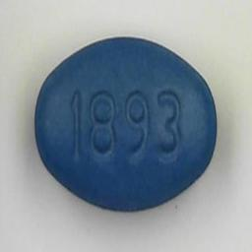
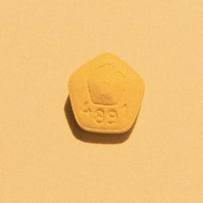
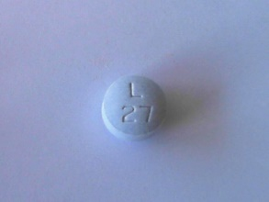
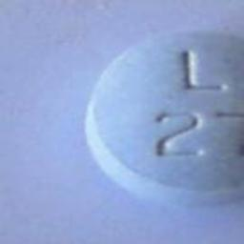
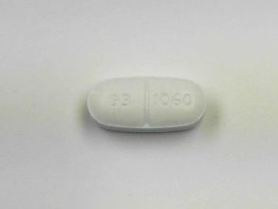
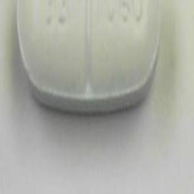
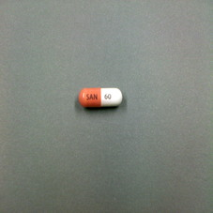
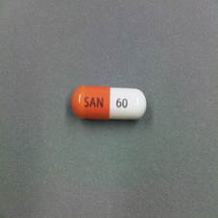
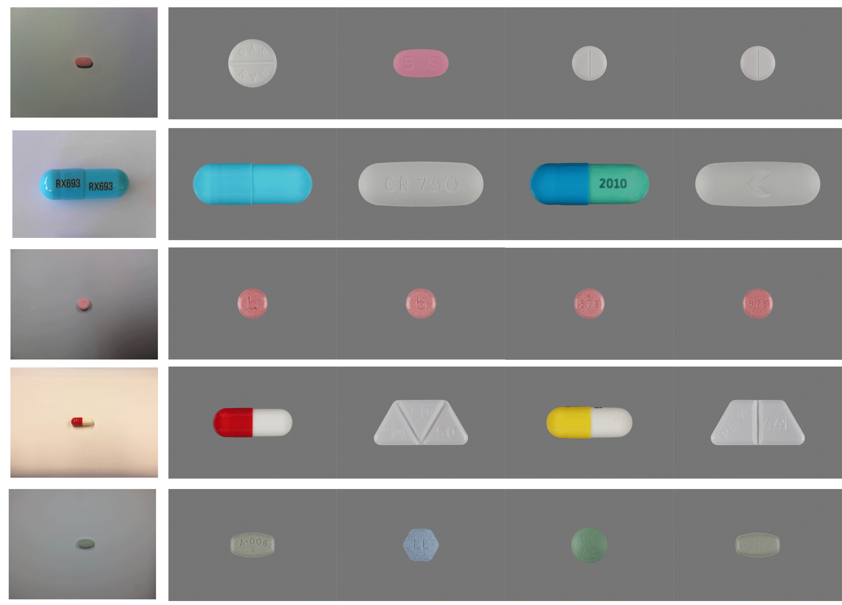
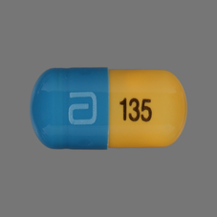
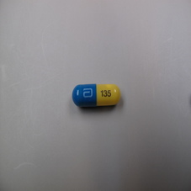
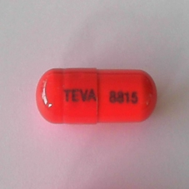
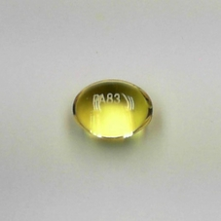
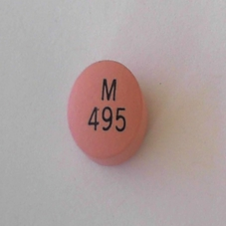
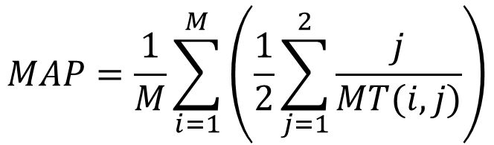
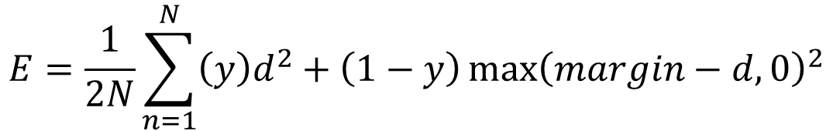
A Survey of Techniques for Fine-Grained Pill Image Matching
Adam Allevato
Andrew Sharp
The University of Texas at Austin
Pill Image Recognition
Experimental Setup
Analysis
- Goal: Produce a system to identify cellphone-camera pictures of consumer medication
- Input: M consumer-quality (CQ) images and N high-quality reference (Ref) images
- Output: M x N matrix of similarity ranks
Preprocessing
Dependence on N (number of pill classes)
- Selective Search was used to crop consumer-quality images
- Networks were tested on selective search images (SS) and raw images (Full), as well as both together (Comb)
- SS alone generally improved mAP by about 0.001 (7%)
[J. R. R. Uijlings et al. 13]
Dataset
2 reference images
&
5 CQ images: taken by
Cellphone cameras
Successful SS Crops
Failure Cases
20
50
100
200
600
T-SNE Embedding (CaffeNet Comb + Hard Neg)
LeNet
1000 pills, 2000 ref images, 5000 CQ images
8 layers
Trained from scratch
Siamese configuration
2-dimensional mapping
Dataset Challenges
- Matching: Classes are unknown at training time
- Fine-Grained: Differences between pills are small
- Small Dataset: Near zero-shot matching task
- Many Classes: 1000-way matching
- Incomplete Data: Need to infer back of pill from front
CaffeNet
21 layers
Fine-tuned last layer
Siamese configuration
20-dimensional mapping
Data Setup
- 30% of images used as test (N=600)
- Hard Negative Mining:
Test networks on training set, generate new training pairs
from false matches
Network
Best Matches (N=600)
Key Idea: Siamese Networks
Training
Matches
Network CQ Top-Ranked Reference Images
- Learn a mapping into an arbitrary N-dim feature space
- Minimize contrastive loss (Y=1 if similar pair, else Y=0):
New Pairs
# 1 # 2 # 3 # 4
$$E=\frac{1}{2N}\sum_{n=1}^{N}{\left(y\right)d^{2}+\left(1−y\right){\max\left(margin−d,0\right)}^{2}}$$
LeNet Full
[Chopra et al. 06]
LeNet Full
+Hard Neg
Network
N-D Feature
Contrastive
Loss
Results: mAP (N=600)
TRAIN
Pair
Network
N-D Feature
-Based on top 2 ranks
(pill front and back)
CaffeNet Full
Network | mAP, N=600 | with Hard Neg
Random | 0.0049889 | -
LeNet, Full | 0.0148293 | 0.0156725
LeNet, SS | 0.0161381 | 0.0174703
CaffeNet, Full | 0.0278952 | -
CaffeNet, Comb | 0.0275352 | 0.0286897
Images
$$MAP=\frac{1}{M}\sum_{i=1}^{M}{\left(\frac{1}{2}\sum_{j=1}^{2}{\frac{j}{MT(i,j)}}\right)}$$
CaffeNet Comb
TEST
Network
N-D Feature
Rank
CaffeNet Comb
+ Hard Neg

